Slide 1


Approaches & Responses to Skills Development – Education Perspective
Presented By
Nicole Brown
Director, Corporate Planning (Acting)
Ministry of Education, Youth & Information
Jamaica

Slide 2


Jamaica In Skills Building Businesss
Skill building is an important instrument to increase the value and quality of labour for improved productivity and economic growth in any society.
It also provides the platform for individuals to become socially conscious citizens.

Slide 3
Jamaica’s Approaches & Responses
The Government of Jamaica is aware of the importance of upskilling its youths (15-29 years) and so it has put systems in place where pertinent initiatives are to be undertaken.
As part of this thrust the Ministry of Education, Youth and Information(MOEYI), (Jamaica) has a key role to ensuring that the labour market needs as met through value added skills and competencies programmes and initiatives.

Slide 4

Jamaica’s Approaches & Responses
Under the Government’s Medium Term Socio-Economic Policy Framework
Human Capital Development Initiative
Early Childhood Education
Youth Development
Nutrition Programme
Labour Force Training (Infusion Of TVET)

Slide 5
Jamaica’s Approaches & Responses
The MOEYI initiatives are also embedded in key priority areas.
(Central Ministry)
Child and Youth Development
Child Care and Protection
Lifelong Learning
Governance and Accountability
Information and Communication
Quality Education and Training
Stakeholder Engagement

Slide 6
Jamaica’s Approaches & Responses
The MOEYI initiatives are also embedded in key priority areas cont’d.
(Hon. Minister Focus Areas)
Early childhood Care and Development
TVET Integration and the STEM Methodology
Safety, Security and Uniformed Groups in all schools
Technology in Education and Administration
Differentiated Instruction for effective teaching and learning
Youth Development and Career Advancement
Efficiency in Public Information and Communication

Slide 7

Jamaica’s Approaches & Responses
POLICY IMPLEMENTATION
TVET Policy
Mathematics Policy

Slide 8
Jamaica’s Approaches & Responses
POLICY IMPLEMENTATION
Aspects of the TVET Policy
      All students undertaking at least one TVET subject
      Emphasis on Stem and Mathematics
          Introduction of robotics, media, visual and performing arts
      Emphasis on ICT

Slide 9
Jamaica’s Approaches & Responses
POLICY IMPLEMENTATION
Mathematics Policy
      Data has revealed that the numeracy rate by students and graduates in the Jamaica education system is low. This trend can impact the Science Technology Engineering Mathematics (STEM) initiative. With that it was paramount to implementation of the Mathematics Policy so that the numeracy rate is improved.

Slide 10
Jamaica’s Approaches & Responses
POLICY IMPLEMENTATION
Aspects of the Mathematics Policy
      Raising mathematics proficiency from early childhood to secondary level
      Improve quality of the teaching of mathematics in school
        Scholarships/grants given to tertiary level students to complete
        mathematics programme

Slide 11
PROGRAMMES/INNIATIVES
Expansion of secondary education with focus on the Career Advancement Programme (CAP)
      Additional two years on the secondary education (12-18 years)
      Additional school years/programmes is aligned to needs of industries

Slide 12
PROGRAMMES/INNIATIVES
Jamaica’s Approaches & Responses
From traditional learning to skills based learning
TVET Degrees
Level 3 and 4 Certificate/Occupational Associate Degree
Certificate in vocational education
National Qualification Framework Governance – Jamaica being revised and implemented(2019-20)

Slide 13
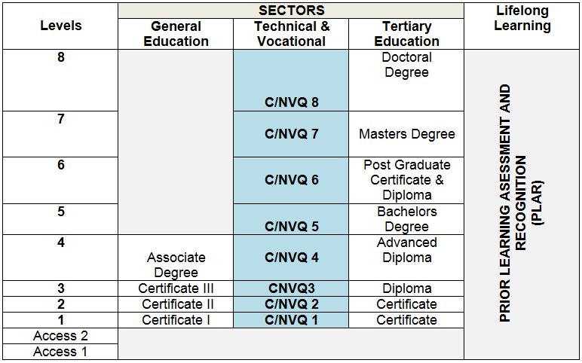
PROGRAMMES/INNIATIVES
Jamaica’s Approaches & Responses
National Qualification Framework – Jamaica

Slide 14

PROGRAMMES/INNIATIVES
Jamaica’s Approaches & Responses
CREATIVE INDUSTRY: OCCUPATIONS INDEMAND

Slide 15
Occupational Associate Degrees
Launched December 8, 2016
Integrated industry-driven curricula
Labour market driven programmes
Professional associations and TVET practitioners serve as Advisors
Skills leading to industry licensure and certifications
Targeted career development
Included on the National Qualifications Framework of Jamaica
Tertiary level qualifications for TVET students
  Linked to industry recognized credentials

Slide 16
Other Intitiatives
Apprenticeship Programme
Business Process Outsourcing (BPO) for greater efficiency and quality services

Slide 17
Other Lifelong Learning Opportunities
Youth Innovation Centres being implemented across the country
This place a greater focus on positive youth development.
This initiative targets at risk youth in Jamaica. There is a suite of programme and services that focus on building resilence, enhancing employability and creating wealth among youths.

Slide 18
Other Lifelong Learning Opportunities
Programmes offered in Youth Innovation Centres
Technologies animation, robotics
Mobile Development
Web development

Slide 19
Other Lifelong Learning Opportunities
THANK YOU

