Slide 1

Work for a brighter future
Report of the Global Commission on the Future of Work
ilo.org/brighterfuture

Slide 2

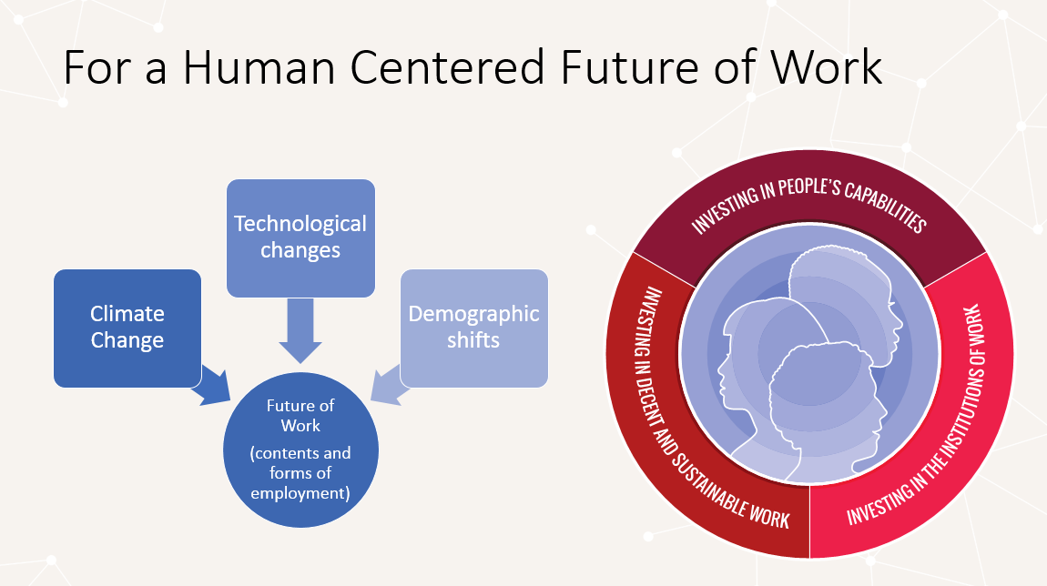

Slide 3
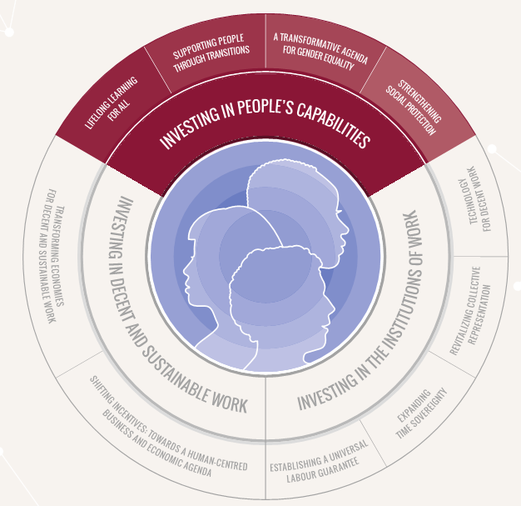
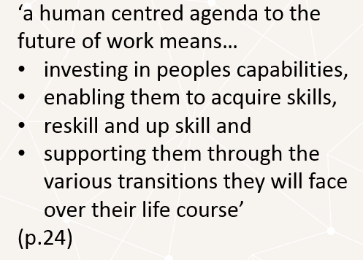
Investing in People´s Capabilities

Slide 4
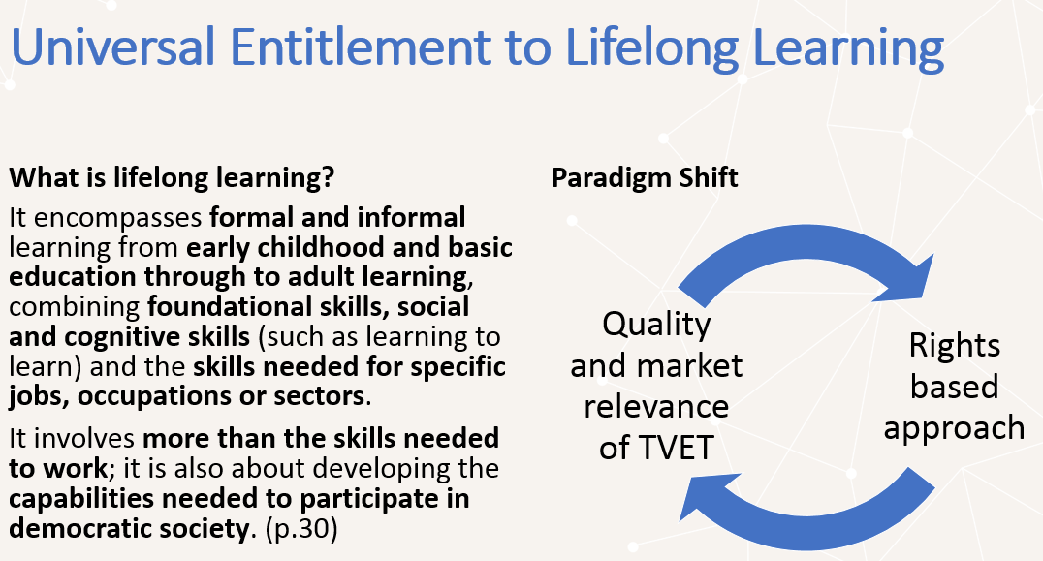

Slide 5

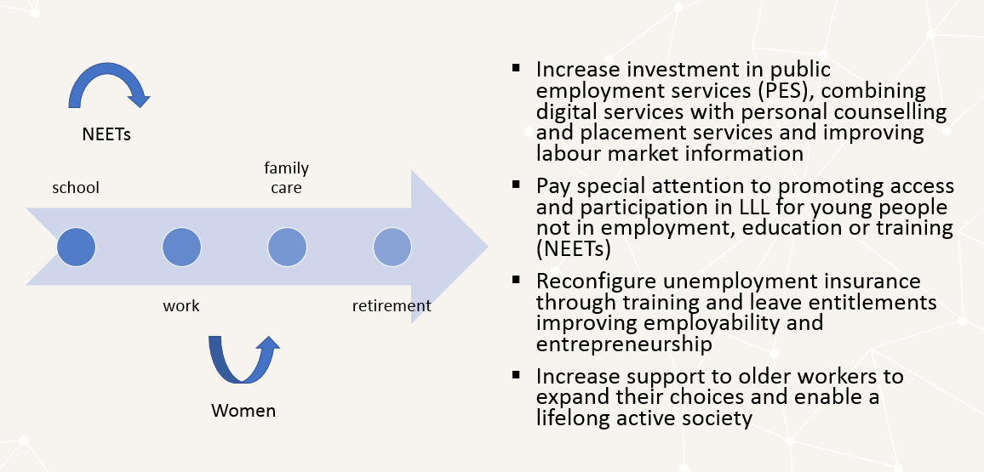
Supporting people trough transitions

