Slide 1
44%
Lectura
53%
Matemáticas
Notes:
44 and 53%. These two numbers summarize, in a nutshell, what the World Bank means when we say that the world is facing a learning crisis.
For the countries where we have data on learning, if we take a simple average of the results on reading and mathematics we find that only close to half of the children in school know how to read and do basic math

Slide 2
¿Qué es la baja calidad educativa?
Así
es
como
lee
la mayoría
de niños
de 3er grado
en países
en desarrollo,
(en el mejor de los casos)
Así
es
como
lee
la mayoría
de niños
de 3er grado
en países
ricos
Agradecemos a Luis Crouch, de RTI International por permitirnos usar la idea de esta diapositiva
Notes:
This is a slide Luis Crouch shared with me. It’s going to show you the difference between how most children read in third grade in a developing country an how most children read in third grade in a wealthy country. I’m going to be silent while it plays. [Then…he lets it play and speaks again when it is finished.] If you’re feeling uncomfortable right now, you should. That’s appalling. Imagine being that child. Imagine what the struggle in school feels like every day. And imagine all of the learning, knowledge, enjoyment and life opportunities that child will never experience because they can’t read well enough

Slide 3
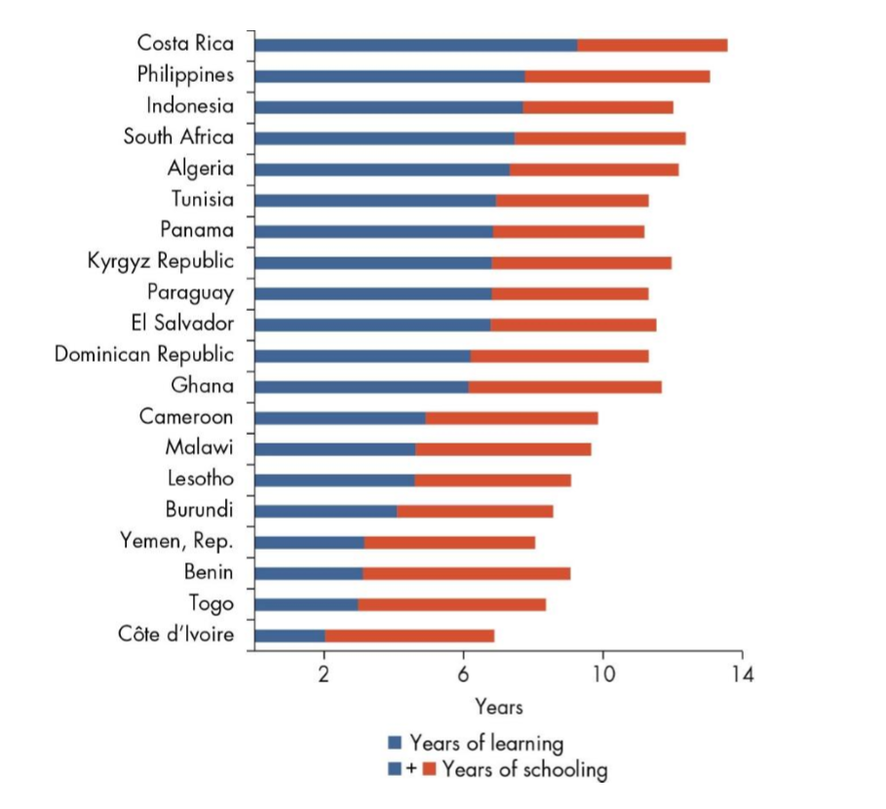
Dramáticas diferencias en aprendizajes

Slide 4
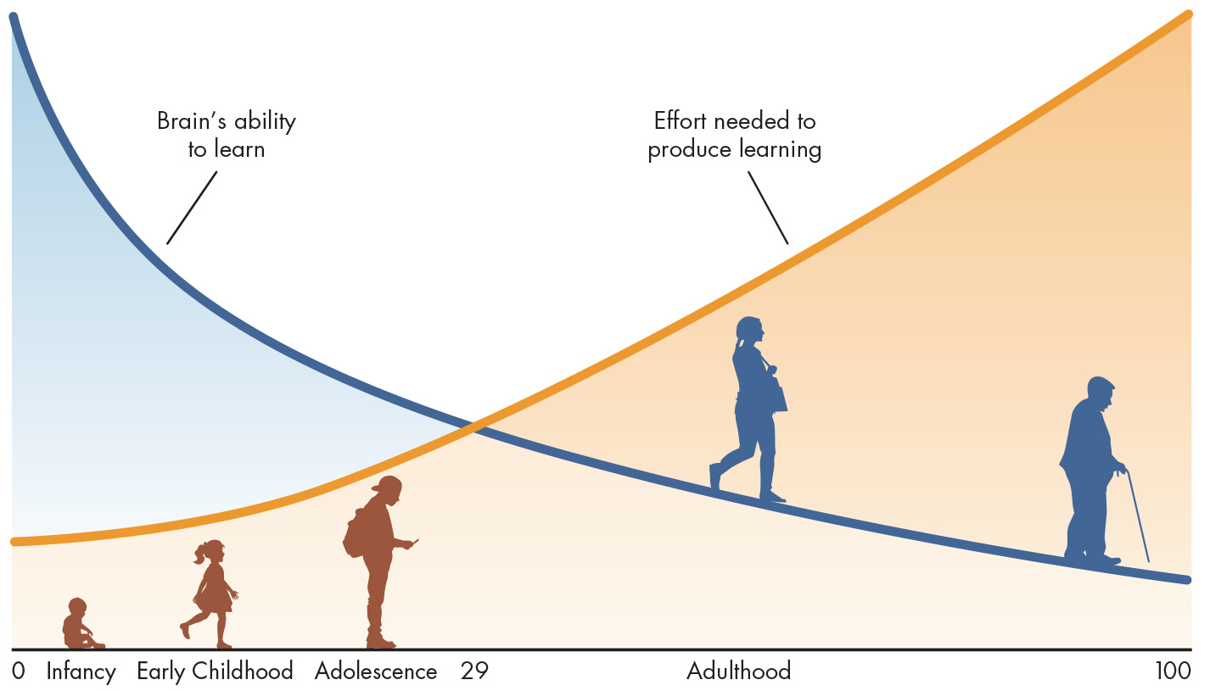
Start early!
Source: Authors’ calculations

Slide 5
HUMAN CAPITAL INDEX: CALCULATION
SURVIVAL
Children who don’t survive don’t grow up to become future workers
SCHOOL
Contribution of quality-adjusted years of school to productivity of future workers
HEALTH
Contribution of health (average of adult survival rate and stunting) to productivity of future workers
Productivity of a future worker (relative to benchmark of complete education and full health)
X
X
=

Slide 6
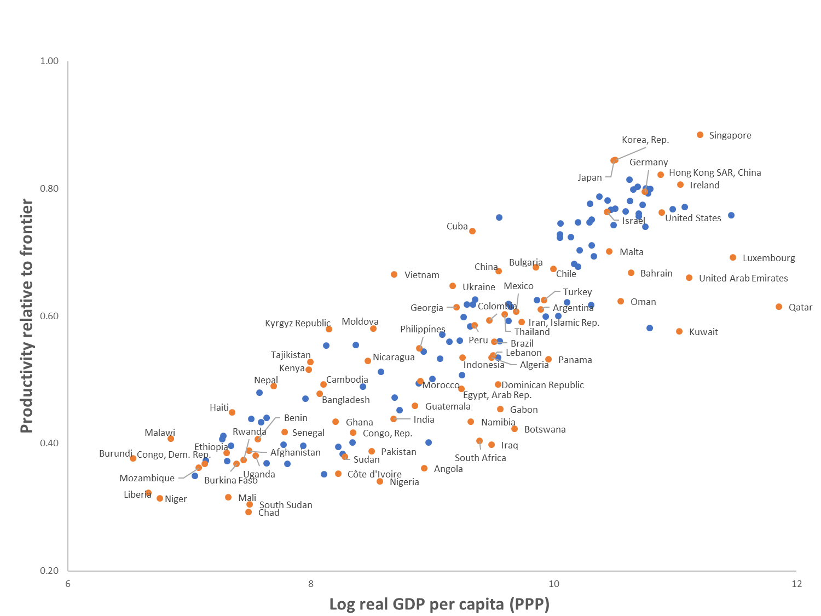
The Human Capital Index, 2018
Source: World Bank staff calculations

