Slide 1

LMIS and Migration Policy in The CARICOM Single Market and Economy
Rosa-Mae Whittier
Free Movement and Labour Officer
CARICOM Secretariat
Labour Migration Workshop
San Jose, Costa Rica
13-14 July, 2017

Slide 2
Presentation Overview
The Caribbean Community (CARICOM) and the CARICOM Single Market and Economy (CSME)
Labour Migration within CARICOM and the CSME
Labour Market Information Systems (LMIS) and the management of labour migration
The CARICOM Regional LMIS
The CARICOM LMIS and intra-regional labour migration

Slide 3

CARICOM and the CSME
The Caribbean Community (CARICOM) is a regional bloc of Caribbean States
CARICOM was established in 1973 through the Treaty of Chaguaramas
There are fifteen (15) CARICOM Member States
The CARCIOM Single Market and Economy (CSME) is a key initiative within CARICOM to foster deeper integration within the Community and promote further growth and development in Member States

Slide 4
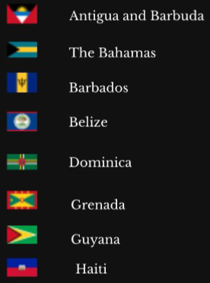
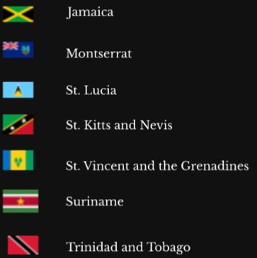

CARICOM Member States

Slide 5

Labour Migration within CARICOM and the CSME -
The CSME Regimes
The CSME consists of five core regimes
Under the Skills, Services and Establishment Regimes CARICOM nationals can move within the region for the purpose of work without a Work Permit
Movement of Labour under the CSME regimes is limited to specific categories of workers
Movement of Skills
Provision of Services
Right of Establishment
Movement of Goods
Movement of Capital

Slide 6
Skills Regime
Right of Establishment Regime
CARICOM nationals seeking to establish a business in another CARICOM Country
Managerial, Supervisory and Technical staff
Services Regime
Service Provider
Relevant staff
Intra-regional labour migration also occurs outside of the CSME regimes, through the Work Permit system.
Artistes
Artisans (CVQ)
Associate Degree Holders
Household Domestics (CVQ)
University Graduates
Sports
-persons
Musicians
Media Persons
Nurses
Teachers

Slide 7
LMIS and Labour Migration
At its Twenty-First Inter-Sessional Meeting (March 2010) the Conference of Heads of Government mandated “the development and adoption of a regional project to build a regional electronic network for labour market information and statistics.” The Conference further noted that this is necessary “to improve data and information retrieval in order to effectively monitor the functioning, performance and economic impact of free movement on the labour market and to calibrate labour market policy”.
“Effective implementation of labour migration agreements requires sophisticated labour market information systems to deal with job opportunity identification, dissemination of job offers and job opportunites, preselection and selection of candidates and legal administrative procedures…full-fledged information systems are the basis for the protection of migrant workers’ rights which are at risk when migration takes place unregistered.” (IOM 2011)

Slide 8
The CARICOM Regional LMIS
Project for the establishment of a regional LMIS commenced in December 2014 with funding assistance under the Tenth European Development Fund - CSME and Economic Integration Programme.
This project is being implemented in collaboration with the International Labour Organisation (ILO) and the University of the West Indies (University Office of Planning and Development/SALISES Cave Hill Campus).
Also partnering with other stakeholders such as the IOM through the Project Steering Committee.

Slide 9
The CARICOM Regional LMIS (cont’d)
Implementation is currently underway.
Scheduled to be operationalized by the end of August 2017.
National networks in each participating Member State to support the regional LMIS, comprising the Ministry of Labour, National Statistics Office, the Social Security Agency and other relevant bodies such as the Immigration Department.

Slide 10
The CARICOM Regional LMIS - Indicators
Labour Force Statistics | General Labour Market Statistics | Social Security Statistics
Labour force participation rate | Labour productivity | Share of population aged 60 years and above benefiting from a pension
Employment-to-population ratio | Average hourly earnings of female and male employees, by occupation, age and persons with disabilities | Share of economically active population contributing to a pension scheme
Status in employment (ICSE) | Working poverty rate (Definition TBD) | Share of unemployed receiving unemployment benefits by economic activity
Employment by sector (ISIC) - 1 Digit - 21 categories | Participation rate of youth and adults in formal and non-formal education and training
Employment by occupation (ISCO) - 2 Digits - 43 Categories
Informal employment rate
Time-related underemployment rate (National threshold)
Unemployment rate
Long-term unemployment rate (over 1 year)
Youth not in education and not in employment (NEET) rate
Hours actually worked
Part-time workers (including involuntary part-time workers)
Persons outside the labour force (Inactivity) rate

Slide 11
Occupational Health Statistics | Public Employment Agency Statistics | Non-National and Overseas Placement Statistics
Occupational injury rate, fatal | Number of vacancies advertised through public employment services (average of per month, over the past three months) | Number of documented foreign labourers in the country (by economic activity and duration of stay, more or less than a year)
Occupational injury rate, non-fatal | Number of new registered Job Seekers in public employment services on a quarterly basis | Ratio of documented foreign laboureres in the country over employed population
Labour inspection rate (inspectors per 1,000 employed persons) | Number of Job Placements through public employment agencies | Number of CARICOM Skills Certificates issued
 |  | Number of CARICOM Skills Certificates verified (duration of stay , more or less than a year)
 |  | Number of workers in Foreign Labour Placement Programmes per year

Slide 12
Industrial Relations Statistics | Legal Framework
Trade Union Membership (% of total labour force, by economic activity and membership type) | Number of Changes in labour laws (in the past five years)
Rate of days not worked due to strikes and lockouts

Slide 13
Complementing the Regional LMIS
The list of indicators for the regional LMIS covers several areas.
To be complemented by other data sources and tools.
Additional data from Immigration.
The CARICOM Applications Processing System – an electronic system for the administration the CSME Skills Regime.

Slide 14
Regional LMIS - Benefits
In addition to allowing for the improved management of the CSME Movement of Labour Regimes, the following benefits would also be derived from the regional LMIS:
Data on labour market demands and available skills to allow for labour market gaps within the region to be filled more efficiently; which would have positive impacts on regional employment levels and economic growth.
Availability of empirical data to inform decision making with respect to labour market policy and other policy areas such as education and training.
Data made available through regional LMIS to facilitate the monitoring of Member States’ progress in achieving the SDGs, in particular SDG Goal 8 – Decent Work and Economic Growth.

Slide 15


Rosa-Mae Whittier
Free Movement and Labour Officer
CARICOM Secretariat
Rosamae.whittier@caricom.org

