Slide 1

The link between Labour Market and Migration and the Rights-Based Approach
Francesco Carella
Labour Migration Specialist
OIT San José, Costa Rica

Slide 2

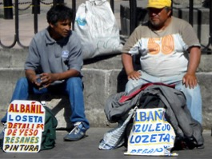

A complex, but ever more relevant link
Individuals
Groups/lobbys
Companies (optimize profits)
Countries
Indispensable to understand contemporary poverty reduction strategies in countries of origin and destination
Applicable to
Unemployment
Brain drain
It has repercussionson…
Underemployment
Informal economy
Professional reintegration of migrants
Job creation through remittances
Salaries

Slide 3



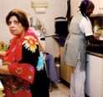


Dynamics in countries of origin and destination
Emitting:
Search for economic opportunities
Education and skill adquisition
Brain drain
Exit of the excess of unqualified workers
Return
Destino:
Employment and Underemployment
Wages
Concentración en la economía informal
Reconocimiento y certificación de competencias

Slide 4


Origin countries
Search for economic opportunities
Most common factor leading to migration
Migration reflects national disparities(supply and demand of certain types of workers)
Concentration in precarious works and with low wages
Migration and change in income
According to a study(2010),
70-90% reported significative income increase
30 – 10% (majority didn’t experimented) = no variation
  Few migrants lived an income decrease

Slide 5


Origin countries
Low-skilled workers
Labour market predetermines internal demand of workforce
Emigration can contribute to relax saturated labour markets
Decent work
Markets requiring low-skilled workers are susceptibles to offer high proportions of low wages, underemployment y unemployment
Hih underemployment levels and high supplies of low-skilled worforce
=
Vulnerable countries to emigration

Slide 6
Destination countries
Employment and unemployment
Initial conditions of the market
Employment
Unemployment
Migrants mobilize toward zones of fast growth rate, higher wages and employment levels
Debate about the contribution of migrants to unemplyment of natives
Studies highlights the absence of negative impacts
Others even highlight a positive impact of migrants, vitalizing porduction and consumption
State administration
Bridge workforce shortages
Prform tasks rejected by natives
Contribute to avoid high inflation
Migrant contribution

Slide 7

Destination countries
Wages
Downward pressure
Studies in western europe do not confirm the existence of such link
Wages tend to resist the downward pressure and amiguity over the impact on employment
Migration has negative impact on wages of low-skilled workers, but «not statistically significant»
The level of organization of the migrants contribute to create differentiated impacts according to diasporas and receiving communities

Slide 8
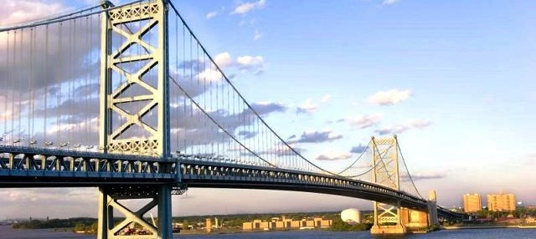

Destination countries
Recognition of skills
Optimize the matching between migrants and the labour market necessities
Origin
Destination
Socio-economic integration of the migrant according to it’s education level
Permit to foreign students recetly graduated to look for work– Demand of high-skilled workers
Bridge to deepen the skills of the migrants and to prepare a brighter return

Slide 9
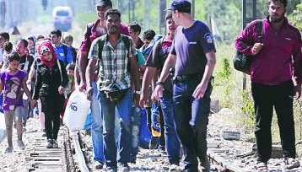

Why is it necessary to promote this nexus?
Origin countries
Importance to develop
integrated systems of information
about migration flows
Destination countries
Better understand the links between labor migration and domestic policies
To confront challenges based on available knowledge
Demographic realityof a population with problems of high aging process
Importance of the integration policies
Favorish a migratory governance responding to necessities
Political decisions about labor migrations benefiting
national employment growth

Slide 10


Adopt a rights-based approach
2 specific conventions
C143 (1975) Migrant workers (complementary dispositions)
C97 (1949) Convention on the migrant worker
Multilateral framework on labour migration(2006)
Recommendation 086 (1949)- Migration for work
Recommendation 151 (1975)- Migrant workers
Complementary conventions
C181 (1997) – Private employment agencies convention
C189 (2011) – Domestic workers convention

Slide 11


Migration and Employment
ILO’s work
Equitable migration program
Principle
Tool
To make migration an option rather than a necessity for everyone
Increase the decent work opportunities in the countries of origin
Elaborate labour migration policies or employment policies
ILO’s support
To enhance the regional social dialogue mecanisms
Tecnical support to prepare bilateral agreements
To develop recognition of skills and skill certification systems

Slide 12
Recommendations
Establecer sistemas de migración atendiendo los intereses de todos los actores e interlocutores sociales
Reparto equitativo de la prosperidad que los migrantes contribuyen a crear
To deepen cooperation through bilateral agreements
To base the legitimacy of labour migration policies on a broad social dialogue
To foster the decent work in the emitting countries
Migration systems serving the interests of all the stakeholders
Equitable distribution of prosperity that migrants contribute to create
Objetivos
Improve the educative opportunities and enhance the skill certicification and recognition
To promote coherence between employment and migration policies
Ratify and comply with the pertinent international legislation

Slide 13

Conclusion and Debate
Thank you for your attention!
Any questions ?

