Slide 1


Social Dialogue and Wage Setting in Uruguay
Hemispheric Workshop
Inter-American Network for Labor Administration (RIAL)

Slide 2
Key Idea
Wages in Uruguay are not the result of the market
It is the result of institutionalized social dialogue
Wage Councils

Slide 3
Historical Background (Until 2005)
1943–1973 (Creation and Rise): Instituted under Law 10.449, they operated consistently to regulate wages and working conditions through a tripartite mechanism (State, workers, employers).
Suspension (1973–1985): During the de facto government, the Wage Councils were deactivated.
1985–1992 (Democratic Restoration): With the return to democracy, the Wage Councils were convened again (Decree 178/985).
Weakening (1992–2005): From 1992, collective bargaining weakened, and wage setting became largely free and conventional (individual contract), without direct interference from the Executive Branch.

Slide 4
Historical Background (From 2005 Onwards)
Systematic convocations. Mandatory convocations upon request from parties (Unions or Employers)
Coverage expanded to almost all sectors
Integration into an economic and social strategy
Consolidation of the system as permanent public policy

Slide 5
Legal Framework
A system articulated on mltiple levels
Law 18.566 (2009) – private sector
Law 18.508 (2009) – public sector

Slide 6
Structure – Upper Level
The Tripartite Higher Council (CST). The highest body for labor coordination, made up of government, employers, and workers to set wage guidelines, define general guidelines, and macroeconomic coordination.
Differentiated Guidelines: Guidelines with differentiated adjustments to prioritize the most submerged sectors
Structure of Agreements: Agreements are projected for two years with semi-annual increases and annual corrective measures.
Broad Agenda: Beyond wages, the agenda includes reducing working hours, productivity, and training.

Slide 7
Structure – Private Sector
Tripartite Sectoral Level (Wage Councils)
The core of the system
Scope: Sets minimum wages by labor category and mandatory increases for all workers in a sector or activity group.
Councils: Organized into groups of industry, commerce, services, domestic and rural work.
Focus: General conditions are negotiated: wages, categories, non-wage benefits, and periodic adjustments.
Results: Decisions are binding for the entire sector, often with a greater impact on SMEs.
Bipartite Company Level
Scope: Agreements between the grassroots union and company management, in which specific agreements and possibly wage supplements are reached.
Focus: Productivity, specific working conditions, additional benefits (health, training).

Slide 8
Structure – Public Sector
Superior Council of the Public Sector: Negotiates with the Executive Branch, autonomous bodies, and decentralized services.
Topics: General wages, working conditions, and employment policies.
Sectoral Level: Negotiation table by branch or sector (e.g., education, health, banks).
Negotiation at the level of each public institution: Specific conditions, professional training, health and workplace hygiene, career development.

Slide 9
Structural Change Starting in 2005
Structural political decision that reconfigured the labor market
Wage re-institutionalization
Abandonment of the logic of negotiation based solely on the market
Reconstruction of a common floor by sector
Recovery of real wages through guidelines combining expected inflation, corrective measures, and growth
Formalization of employment.
By establishing sectoral minimum wages, incentives to informality are reduced.
Improvement of the quality of labor relations

Slide 10
Role of Social Actors
Workers (PIT-CNT)
High organizational capacity and recognized legitimacy
Active participation in negotiation
Ability to pressure and propose
Employers
Sectoral representation
Defense of competitiveness
Sustained participation in the system

Slide 11
Role of the State
Calls and coordinates
Proposes guidelines
Acts as an arbitrator
Has decision-making authority
Is not neutral; it is the guarantor of the system's functioning

Slide 12
Positive Impacts of the System
Social dialogue in Uruguay is not decorative; it is structural
Real negotiation space
Distribution mechanism
Defines how income is distributed
Stabilizing tool
Reduces conflict
Orders expectations
Legitimacy and representativity of social actors
Wage decisions are not unilateral

Slide 13
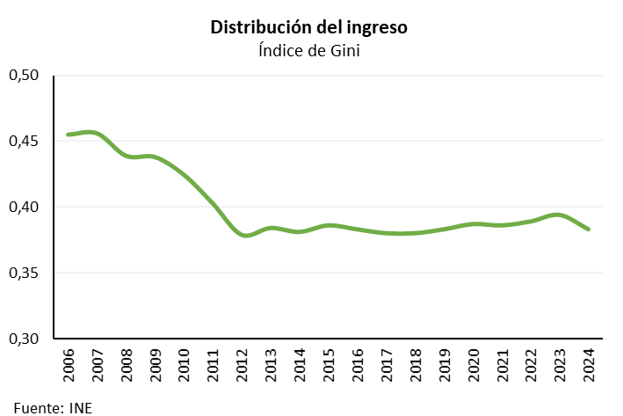
Results
Income Distribution
Gini coefficient
Source: INE

Slide 14
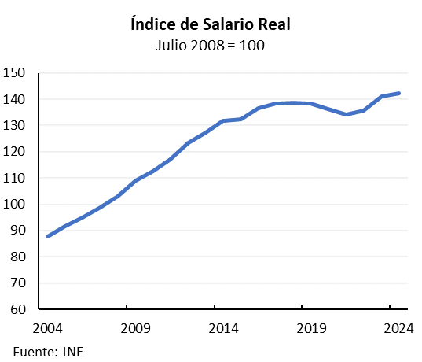
Results
Real Wage Index
July 2008 = 100
Source: INE

Slide 15
Analysis
If we observe the evolution of real wages and inequality in Uruguay, we see two consistent trends: the sustained growth of wages and the reduction of the Gini index.
This coincides with the period of consolidation of collective bargaining and the Wage Councils.

Slide 16
Real Wage Growth
Average Real Wage Index (IMSR) accumulated a positive variation of 2.26% compared to inflation.
Source: INE
In the private sector, the increase was 2.2%, while the evolution in the public sector was 2.34%.
Source: INE
2025

Slide 17
Conclusiones
1. Conflict resolution
Wage Councils do not eliminate conflict: they order it and process it institutionally.
They transform distributional tensions into negotiation, preventing them from expressing themselves as crises.
2. Regulation of labor relations
Wage councils are the main negotiation mechanism. They stablish common rules, reduce arbitrariness, and balance power between capital and labor.
3. Democratic stability
Wage councils contribute to dialogue between parties. They strengthen democracy.

Slide 18
Social Dialogue and Wage Setting in Uruguay
THANKS!

