Slide 1
How can skills shortages impact the climate
NewClimate Institute
Rory Geary
February 2026
r.geary@newclimate.org

Slide 2
1. Trends in Energy Transition Jobs
AGENDA
From job creation engine to skills bottlenecks
Shortages of workers & skills present major risks to achieving global climate targets.
2. The Climate Impacts of Green Skills Shortages
How might a shortage of workers impact future emissions and global warming
3. Barriers to Building a Green Workforce
What is preventing the expansion of energy sector workforces

Slide 3
Energy employment Trends
Job Creation & Skills Bottlenecks
1

Slide 4
what DOES THE ENERGY TRANSITION MEAN FOR JOBS?
Higher Demand For Some Occupations
  More electricians needed across power, industry and building sector transition tasks
New Skills Needed For Other Occupations
  Plumbers need to learn to install heat pumps, civil engineers to build offshore wind farms
Brand New Occupations Being Created
  Offshore wind maintenance technicians, greenhouse gas accountants
Demand Will Decline for Some Traditional Occupations
  Coal mining and other fossil fuel occupations facing structural decline

Slide 5
THE ENERGY TRANSITION IS A JOB CREATOR
2% of the global workforce employed in energy, (IEA, 2025) and the share is rising.
  Countries hosting manufacturing have significantly higher shares.
Construction of electricity generation is the biggest employment driver in recent years.
Data Source: IRENA Renewable Energy & Jobs 2025 (direct jobs only)

Slide 6
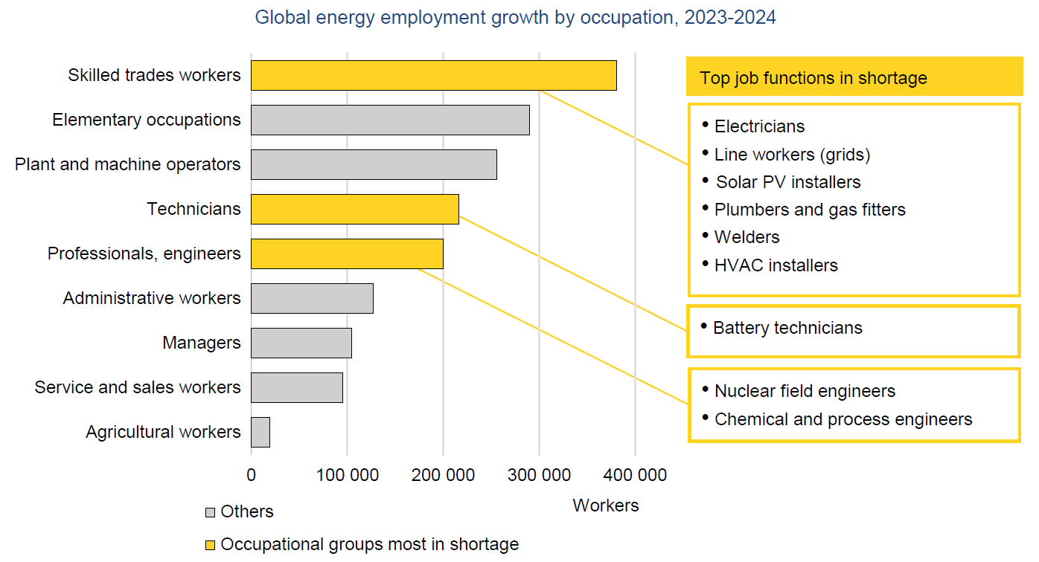
Skills shortages emerging as major bottleneck for climate targets
Surveys of firms consistently highlight skills shortages as slowing energy transition progress
Over half of firms reporting critical hiring difficulties for technical and supervisory roles
  (IEA World Energy Employment 2025)
Chart Source: IEA World Energy Employment 2025

Slide 7
The Climate Impacts of Green Skills Shortages
2

Slide 8
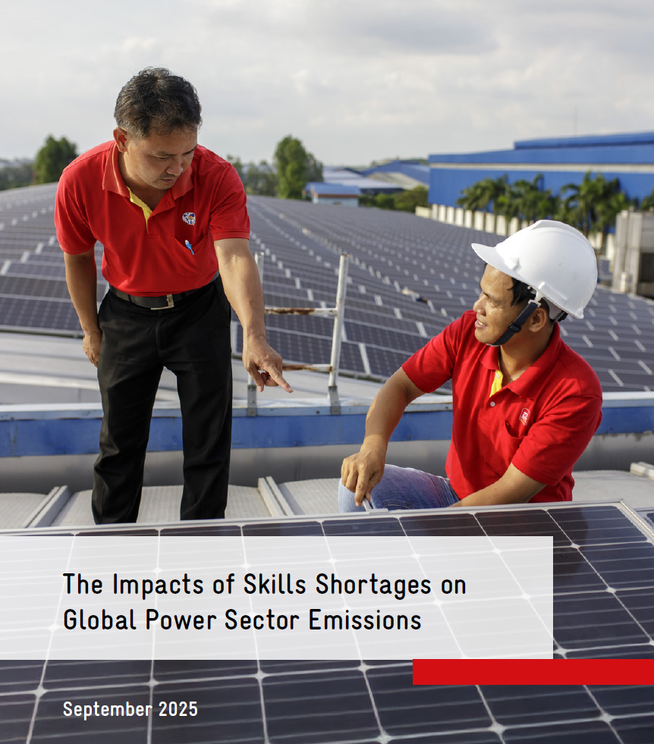
Modelling Labour Demand & Supply in the Power Sector
Using a novel, theoretical model, a study by NewClimate Institute explores possible relationships between shortages of workers for the energy transition & global emission pathways.
Key features of the model:
  Labour demand estimated using employment factors & IEA scenarios.
  Labour supply calculated as a delayed response to labour demand.
  New renewable energy power capacity derived from the available number of workers.
  Different scenarios are explored, assuming different rates of delay.

Slide 9
Labour shortages could derail transition progress
TRIPLING R.E by 2030 SCENARIO ANALYSIS
50% increase in demand for power sector workers by 2030.
If only 20-60% of new labour demand is met annually, global renewable power generation capacity could fall nearly 10% short of the pledged tripling target by 2030.
By 2030, emissions could be 12% above the level achievable from countries’ announced pledges and nearly double by 2050.
This would push the global power sector closer towards a 2.4°C warming pathway instead of 1.7°C.

Slide 10
Problem Summary
Accelerating the global energy transition requires a rapid and large-scale expansion of the renewable energy workforce.
Unaddressed, global labour shortages can quickly compound.
Delays in labour supply slow renewable power development.
This can lead to higher emissions pathways and greater climate damages.

Slide 11
Barriers to building the green workforce
3

Slide 12



Where will new workers come from?
To address labour shortages, countries can draw from different groups of workers.
Graduates
Domestic students graduating from relevant third level courses.
Workers in fossil fuel industries & other technical sectors
Workers with appropriate experience can swith into the renewable energy sector.
Migrant workers
Many countries rely on skilled migrants to fill vacant positions in their R.E sectors.

Slide 13
What barriers do these groups face?
Graduates
- Insufficient number of places available, and,
- Challenges with the labour market-relevance of curricula.
Workers in fossil fuel industries & other technical sectors
- Worker transitions from fossil fuel to renewable industries remain limited.
- Likely due to mismatches in the location and timing of new jobs, insufficient retraining support and differing job characteristics.
Migrant workers
- Few migration partnerships exist which target renewable energy skills.
- Migration outflows present risks to the climate targets of origin countries.
Each group faces unique challenges to joining renewable energy industries.

Slide 14
Guiding questions for policy design
4

Slide 15
Key questions to understand the country specific challenge
How do the climate and energy plans of your country impact occupational demand?
Does the current educational and training offering provide relevant skills and sufficient numbers of graduates for critical occupations?
  Do graduates have labour market ready skills after completing their studies?
  Are there enough graduates from courses to supply critical occupations for the energy transition?
What skills shortages are present in your country?
  Is there a mechanism to regularly communicate with firms to understand their labour market challenges?
What barriers prevent current workers from training and moving into energy transition sectors?
  Does the location and working conditions of jobs compare well?
  What costs does the individual have to bear to reskill?
How is migration affecting the supply of skilled workers for your country’s energy transition?

