Slide 1





The National Qualifications Frameworks as Concrete Tools for Education-Labor Coordination
Implementation of the National Qualifications Framework for Education Careers (MNCCE-CR)
Workshop “Towards a greater coordination between education and labor in the Americas”
May 4, 2023
Juan Ricardo Wong Ruiz
Executive Director of the National Council of Private University Higher Education

Slide 2
“A qualifications framework constitutes a reference instrument that describes the learning results that are expected at the end of the different levels of training in the educational continuum, with the purpose of having quality standards, and reference frameworks that harmonize countries’ education systems, to promote mobility and academic and job recognition.”
Qualifications framework for Central American higher education, CSUCA, 2018.

Slide 3
Learning outcomes
“…Statements about what the student is expected to be able to do, understand or demonstrate once a learning process has finished (Manual of the European Credit Transfer System).
They describe in an integrated way the knowledge, skills and attitudes that students will acquire in a training process. These results must be observable or measurable, and are written using a dynamic verb, that is, it refers to an action, not a state (CSUCA, 2018, p. 15)..."

Slide 4

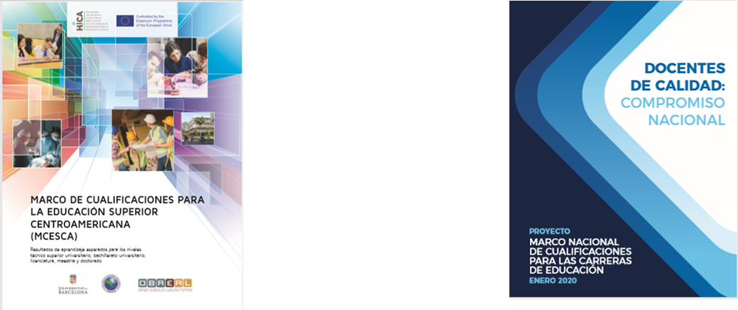
BACKGROUND
Qualifications Framework for Central American Higher Education MCESCA

Slide 5
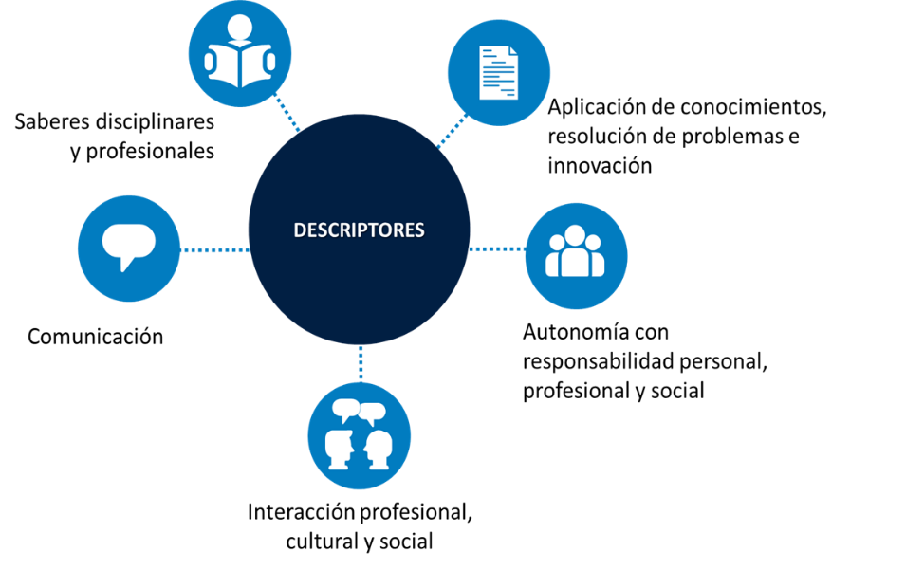
Qualifications Framework for Central American Higher Education
The MCESCA presents expected learning outcomes ordered progressively in five levels (Higher Technical University, University Baccalaureate, Bachelor's, Master's and Doctorate.)
It groups the expected learning outcomes into five categories or descriptors:
Disciplinary and professional knowledge
Knowledge application, information analysis and problem solving and innovation
Autonomy, personal, professional, social responsibility and decision-making
Communication
Professional, cultural and social interaction
Disciplinary and professional knowledge
Application of knowledge, problem solving and innovation
Descriptors
Communication
Autonomy with personal, professional and social responsibility
Professional, cultural and social interaction

Slide 6
Its preparation is the result of inter-institutional work
The MNCE-CR is an inter-institutional effort where several institutions participated, and culminated in the signing of an Inter-institutional agreement, where the following participate:
The Ministry of Public Education
The National Council of Rectors of State Universities
The National Council of Private University Higher Education
Professional College of Teachers and Graduates

Slide 7
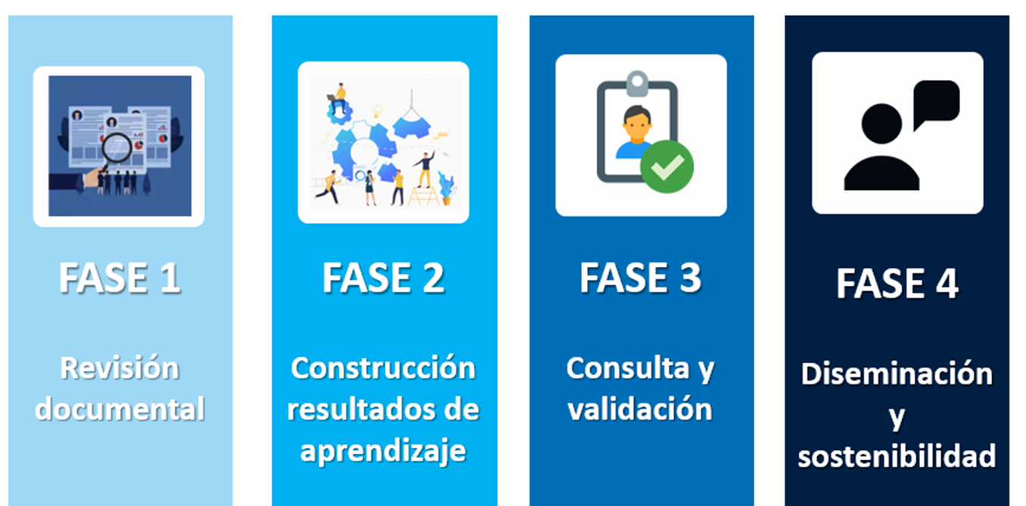
Route of the MNCCE-CR
PHASE 1
PHASE 2
PHASE 3
PHASE 4
Document Review
Building learning outcomes
Consulting and validation
Dissemination and sustainability

Slide 8
Skills development
The Ministry of Public Education of Costa Rica has as its guiding principle in its educational model, the development of skills…
These skills are:
Competences for responsible citizenship
2. Skills for life
3.Skills for employability

Slide 9
IMPLEMENTATION OF THE MNCCE-CR

Slide 10
Work plan for updating education careers
The National Inter-institutional Committee has scheduled the following implementation activities:
Preparation of the update guide aimed at private universities with education careers
Socialization and training regarding the update guides
Presentation of update requests by universities.
Review and authorization of requests
Implementation of updated careers.
Monitoring and accompaniment of the implementation process.

Slide 11
Technical considerations in the updating process
Referent for decision-making in the educational “what to do”.
It guides the implementation of the document investigation and the diagnosis.
To elaborate or modify the study plans, all the elements of the study plan are considered.
The matrix of the expected learning results of the MNC-CE-CR must be read in its entirety.
The expected learning results are written so that they are interpreted at the highest levels of knowledge of a university level, the objectives or competencies will be established by each University.
The expected learning results must be evidenced both in the professional academic profile and in other curricular elements, depending on the type or model of curricular design that is chosen.
In the structure and curriculum, a clear relationship must be identified between the expected learning results of the MNC-CE-CR and the courses, subjects or modules that comprise them.

Slide 12
Recommendations for incorporating learning outcomes
The incorporation of learning results must be linked to the processes of designing and modifying the study plan of a university degree
2.Verification of coherence and relevance of the curricular elements
1. Diagnosis or curricular analysis

Slide 13
Verify that the curriculum meets the learning outcomes
JUSTIFICATION AND RATIONALE
Justifies and bases the design or modification of the study plan of the career
OBJECTIVES (GENERAL AND SPECIFIC)
Purposes of career training based on the professional academic profile
MESH AND CURRICULAR STRUCTURE
Including the descriptors and learning outcomes in the features of the professional academic profile entails also including them as part of the structure, curriculum, and other curricular components.
PROFESSIONAL ACADEMIC PROFILE
Reference will be made to the inclusion of the expected learning outcomes of the MNC-CE-CR in the professional academic profile

Slide 14
STEPS TO MAKE THE INCLUSION OF LEARNING OUTCOMES
A- Design of new careers:
Carrying out the diagnosis.
Identification of the capacities, knowledge, abilities, attitudes, values ​​or competences necessary in the formation of the educator.
Drafting of the graduate's own professional academic profile features (they are not transcribed from the MNC-CE-CR).
Comparative analysis of the features of the profile proposed in the study plan with the descriptors and expected learning results of the MNC-CE-CR.
When identifying the expected learning results of the MNC-CE-CR, aspects that have not been considered are included, integrated or new features are elaborated if necessary.

Slide 15
B- Modification of careers approved at the University:
Carrying out a curricular analysis to identify the needs to update the career.
Comparative analysis of the features of the profile indicated in the current study plan, identify those expected learning results or aspects of the descriptors of the MNC-CE-CR that need to be included in the features of the new profile.
Updating of the professional academic profile of the graduate.

Slide 16
Lessons learned and challenges
Consider the MNC-CE-CR as an opportunity to improve quality training for education professionals.
Promotion of coordinated inter-institutional work to improve the academic training of education professionals.
Establishment of actions that include a permanent dialogue between the parties involved in teacher training processes and with the education sector for the implementation of the MNC-CE-CR.
Strengthening of inter-institutional work to update and improve teacher professional development.
Active participation of the university teaching staff, people in charge of managing the study plans in the design and modification processes for decision-making; as well as, the appropriation of the educational intentions that will be reflected in the university careers.

Slide 17
Integration of the human rights approach in the training of professionals and in the updating of university professors, in order to incorporate it as conceptual, attitudinal and procedural knowledge throughout the entire curriculum.
Assignment of the human, technical and budgetary resources necessary for the implementation of the MNC-CE-CR in the Universities.
Ensure the incorporation of actions that strengthen the integral health (mental, emotional and physical) of education professionals.
Continue with the development of the MNC in other university disciplines

Slide 18

Thank You

