Slide 1

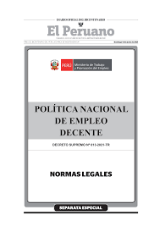

Institutional Coordination: among the Ministries of Labor and Education
NATIONAL POLICY OF DECENT WORK
8.5 Achieve full and productive employment and decent work for all women and men, including for young people and persons with disabilities, and equal pay for work of equal value​
8.6 Substantially reduce the proportion of youth not in employment, education or training
NATIONAL POLICY OF DECENT WORK (D.S. N°013-2021-TRA)​
Provide the framework and guidelines for multisectoral action that addresses the public problem of the high decent employment deficit, which is a priority for the government.

Slide 2
Institutional Coordination: among the Ministries of Labor and Education
National Policy of Decent Work approved by DS. N° 013-2021-TR.​
Its objective is to promote the institutional, economic and social conditions necessary to ensure that workers can access decent and productive work on equal terms and free of any discrimination.
National Policy of Decent Work​
OP1: Increase the job skills of the working-age population
OP2: Strengthen the link between labor supply and demand
OP3: Increase the generation of formal employment in the productive units
OP4: Expand access to social protection, rights and social benefits for workers​
OP5: Increase equality in the employment of the potential labor force​
OP6: Generate an adequate social and institutional environment in the country​
Quality higher and technical-productive education service (MINEDU)​
National Program of Scholarships and Educational Loans (MINEDU)
Dissemination service for job training vacancies required by companies (MTPE).​
Incentive granting service for youth employability (MTPE)​
Labor training service (MTPE)​
Labor skills certification service (MTPE)​
Job training for vulnerable groups (MTPE).​
Platform for the identification of the wage gap between men and women (MTPE).​

Slide 3

Institutional Coordination: among the Ministries of Labor and Education
OP2: Strengthen the link between labor supply and demand​
L.2.2. Articulate the training offer with the occupations and skills demanded by companies
L.2.3. Provide information on vocational and professional guidance free of gender stereotypes to women and men in their diversity of working age.​
Information service on labor competency standards and qualifications
Information portal on training and employment trajectories, and supply of higher and technical-productive education (ESTP) and job training.
National Qualifications Framework
It is expected that the labor competency standards and occupational profiles that the MTPE possesses will serve as input for the development of qualifications.
https://www.ponteencarrera.pe/pec-portal-web/

Slide 4
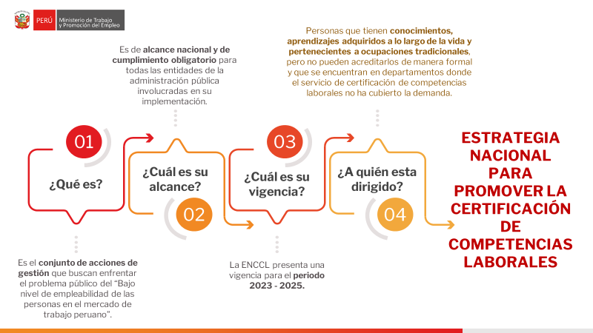
People who have knowledge, learning acquired throughout life and belonging to traditional occupations, but cannot formally accredit them and who are in departments where the labor skills certification service has not covered the demand.
It is national in scope and mandatory for all public administration entities involved in its implementation.
NATIONAL STRATEGY TO PROMOTE THE CERTIFICATION OF LABOR COMPETENCES
What is its scope?
What is its validity?
Who is it addressed to?
What is it?
It is the set of management actions that seek to address the public problem of "low level of employability of people in the Peruvian labor market”.
The ENCCL is valid for the 2023-2025 period.

Slide 5

Coordination
A large percentage (69%) of workers are in the labor market and only reached the level of secondary education and this has an impact on the productivity and competitiveness of companies.
Informality in Peru rose to 76.9%
All this implies that workers acquire skills in the labor market and that they are not being recognized and therefore do not return to the educational market.
Thus, to populate the National Qualifications Framework, coordination with the productive sectors and the public sector is required to increase the competency standards that will serve as an input to develop qualifications and thus POPULATE the MNCP.
Participation in the occupied EAP = 69%
What has been prioritized?
Prioritized Profiles
No level
Primary
Secondary
Superior, Non-university
Superior, University
Occupied EAP
Median employment income (soles)
Source: ENAHO (2022)

Slide 6



National Qualifications Framework in Peru
National Qualifications Framework in Peru – MNCP
Actions executed:
Since 2019, in coordination with the Ministry of Education, work has been done on the creation of a qualifications framework.
With Supreme Decree No. 012-2021-MINEDU, the National Qualifications Framework of Peru (MNCP) was created and the National Commission was created to monitor the implementation of the MNCP.
The Qualifications Framework is national in scope and considers 8 qualification levels.
The certification of labor competencies constitutes a path towards qualification.
8
7
8
6
4
5
Levels
2
3
1
Dimensions & subdimensions
Knowledge
Skills
Application
What a person knows, understands and is able to assimilate from the educational or training process, or from their own experience.
For communication (first and second language)
Socio-emotional (teamwork and adaptability)
Cognitive (information management and problem solving)
Techniques (management of resources, instruments, techniques and technology)
Responsibility
Autonomy

Slide 7
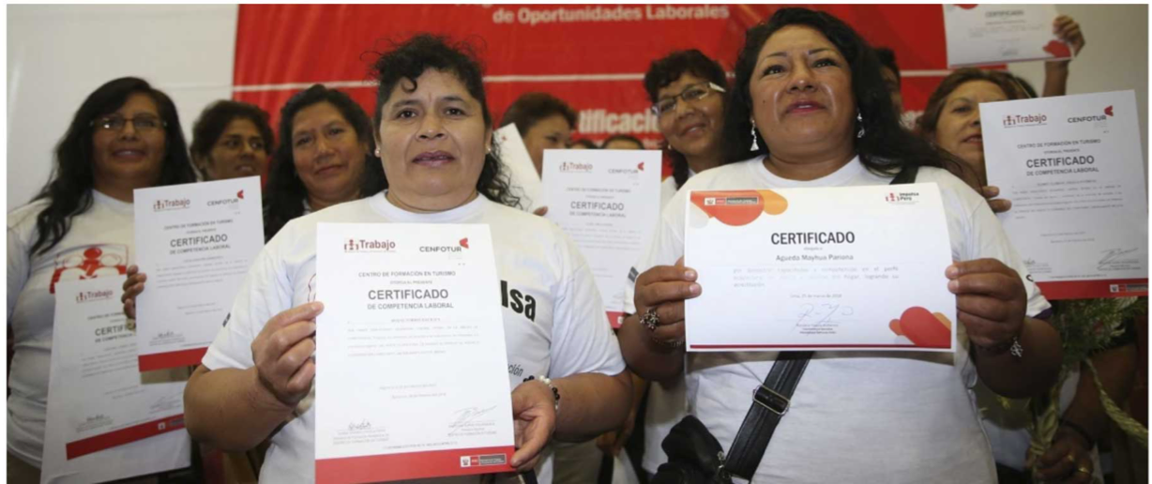
Certification of labor competencies
It is the "public, formal and documented recognition of labor competencies demonstrated by a person, regardless of the way in which they were acquired, in accordance with a labor competency standard."
It makes visible the skills acquired outside the educational market
Can my labor competency certificate be recognized to enter a training program?
NO Facilitates insertion into the training world It is a pending task that can be achieved through the National Qualifications Framework

Slide 8
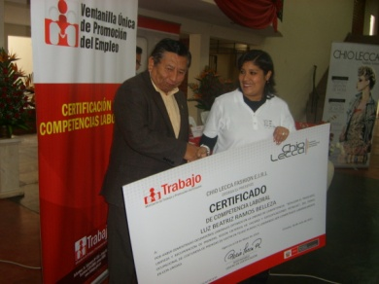
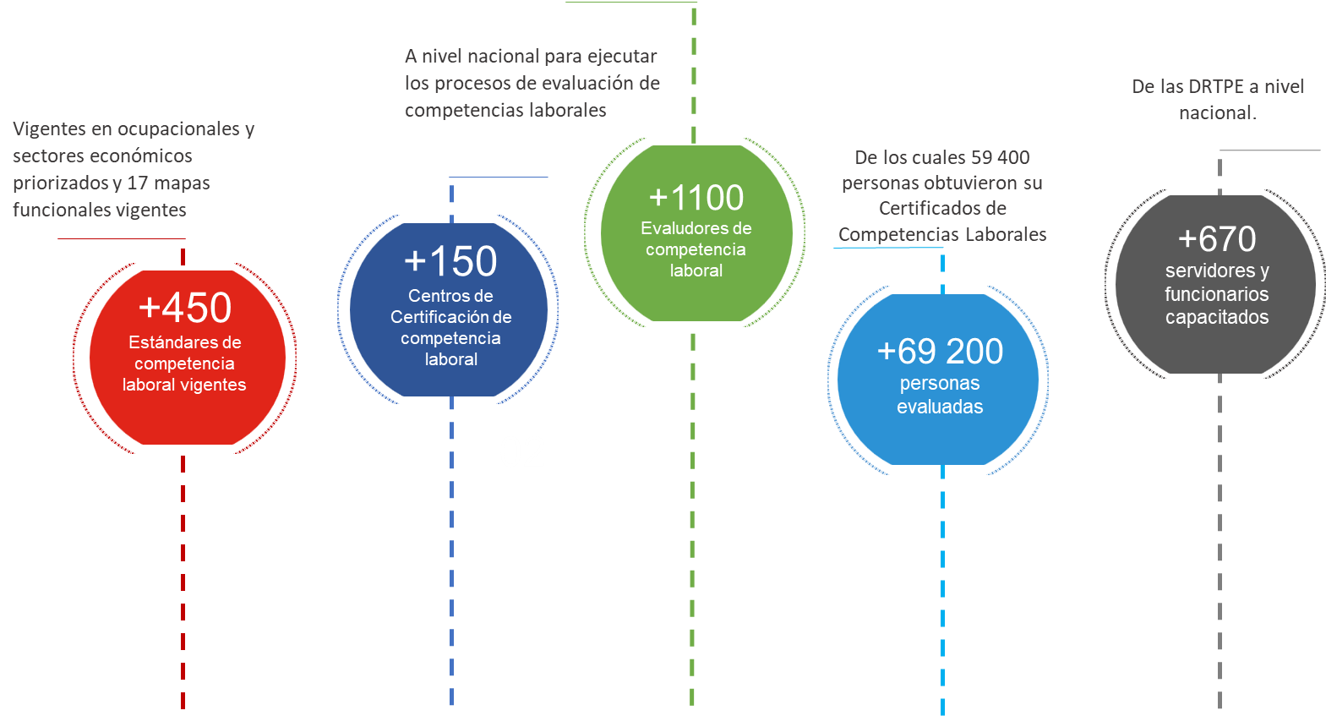
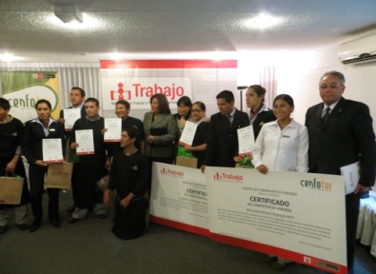
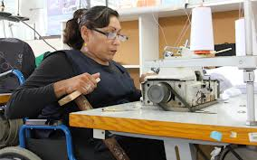
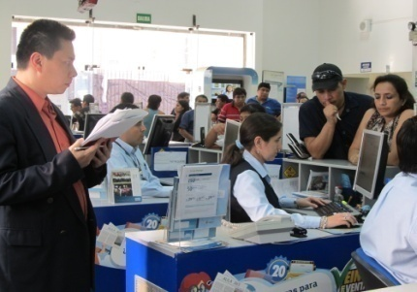
SOME RESULTS IN THE CERTIFICATION OF LABOR COMPETENCES
At the national level to execute the processes of evaluation of labor competencies
Of the DRTPE at the national level.
Currently in occupations and prioritized economic sectors and 17 current functional maps
Of which 59,400 people obtained their Labor Competencies Certificates
Labor competency evaluators
Trained public servants and officials
Labor Competency Certification Centers
Current labor competency standards
People evaluated

Slide 9
The recognition of labor competency certificates and other mechanisms is urgent given the large population that learns a trade and accumulates skills outside the educational market.

