Slide 1



The Role of Ministries of Labour in Addressing Environmental Transformations in Latin America and the Caribbean
Andrés Espejo
Economic Affairs Officer
UN-ECLAC
Nassau, Bahamas
26 February 2026

Slide 2



This presentation forms part of the United Nations Development Account project “Labour inclusion to address climate change and its impacts on the future of work in Latin America and the Caribbean”, implemented by ECLAC.
https://www.cepal.org/es/proyectos/inclusion-laboral-verde-enfrentar-cambio-climatico-sus-repercusiones-futuro-trabajo

Slide 3
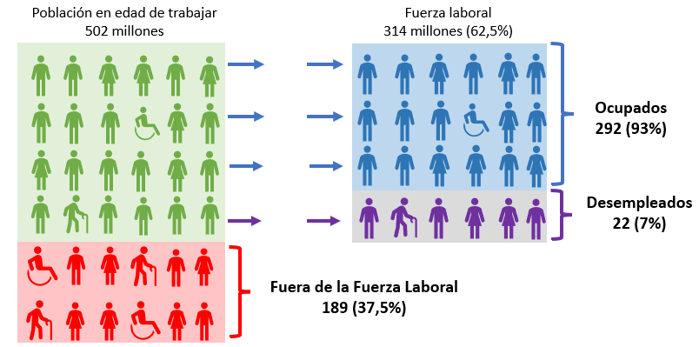
Labour inclusion and climate change: challenges in contexts of inequality
Latin America and the Caribbean (29 countries): population structure, 2022
Participation in paid employment is essential but not sufficient to achieve labour inclusion.
Of the 292 million employed people:
1 in 2 are in informal employment.
Nearly one-fifth live in poverty.
4 in 10 earn less than the minimum wage.
Fuente: Comisión Económica para América Latina y el Caribe (CEPAL), sobre la base de estimaciones de ILOSTAT. Disponible [en línea] https://ilostat.ilo.org/es/data/
a Argentina, Bahamas, Barbados, Belice, Bolivia (Est. Plur. de), Brasil, Chile, Colombia, Costa Rica, Cuba, Ecuador, El Salvador, Guatemala, Guayana, Haití, Honduras, Jamaica, México, Nicaragua, Panamá, Paraguay, Perú, Rep. Dominicana, Santa Lucía, Suriname, Trinidad y Tabago, Uruguay, San Vicente y las Granadinas y Venezuela (Rep. Bol. de).
b La población en edad de trabajar (PET) corresponde a 15 años o más.
Notes:
Aunque la distribución del ingreso en América Latina y el Caribe mejoró a partir de la década de los 2000, esta tendencia se estancó alrededor de 2015 y la región sigue exhibiendo una de las peores distribuciones del ingreso en el mundo.
La desigualdad no es solo el resultado del funcionamiento de la economía, sino también un determinante clave de ese funcionamiento, porque define el acceso de los agentes económicos a capacidades y oportunidades, y modela las reglas de juego que rigen sus decisiones. Su mensaje central es que la desigualdad conlleva grandes costos de eficiencia, lo que redunda en que su superación sea una condición necesaria para el desarrollo.
Uno de los indicadores más reconocidos de la desigualdad de la distribución del ingreso es el Índice de GINI, el que varía entre 0 y 1, siendo 1 la mayor desigualdad. Como publicamos en el Panorama Social de América Latina y el Caribe 2023, entre los 13 países para los que se cuenta con datos comparables, este índice llegó a 0,45 en 2022. En comparación, los últimos datos publicados por el Banco Mundial muestran que este índice alcanza un promedio de 0,42 en África, segunda región más desigual, aunque tiene una mayor dispersión entre países. Esto mientras el promedio mundial llega a 0,37 y los países de la OCDE no latinoamericanos promedian 0,30.
De esta manera, como promedio en América Latina, la población del diez por ciento superior de la distribución de ingresos percibe el 34,6% del total de los ingresos, mientras el primer decil percibe solo el 1,7%.

Slide 4
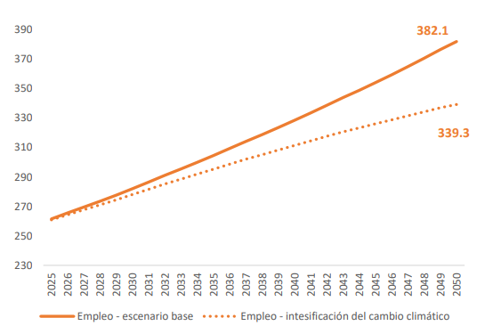
Latin America and the Caribbean is among the regions most exposed to and disproportionately affected by climate change
Latin America (17 countries): Effects of climate change on employment, 2023-2050(Millions of people)
Significant increase in extreme weather events:
Between 1980–1999 and 2000–2021, the number of weather events nearly doubled, rising from 28 to 53.5.
The number of people impacted by these events increased from 4.5 million to 7.2 million during the same period.
In Latin America, in the absence of compensatory policies, it is estimated that the effects of climate change will lead to a loss of around 43 million jobs (10% of the workforce) by 2050.
They will affect activities such as agriculture and tourism to a greater extent.
Fuente: CEPAL, 2024. Estudio Económico 2024

Slide 5
How do climate challenges affect labour markets?
DIMENSIONS
MECHANISMS
DEMANDS
CLIMATE DISASTERS
CHANNELS
Job destruction and creation
DETERIORATION
Sectoral contraction
OCCUPATIONAL
HEALTH
Sectoral reallocation
RISING TEMPERATURES
SUPPLY
DESTRUCTION
INFRASTRUCTURE
AND ASSETS
Deterioration of health and well-being
Reduced availability and capacity
DECARBONISATION OF ECONOMIES
Migration
Time poverty
LOSS OF VIABILITY
LIVELIHOODS
PRODUCTIVITY
ENVIRONMENTAL
DEGRADATION
CONTRACTION
Widespread reduction
TIME USE
Declining and vulnerable incomes
Fuente: Cortínez y Livert, 2026. CEPAL.

Slide 6
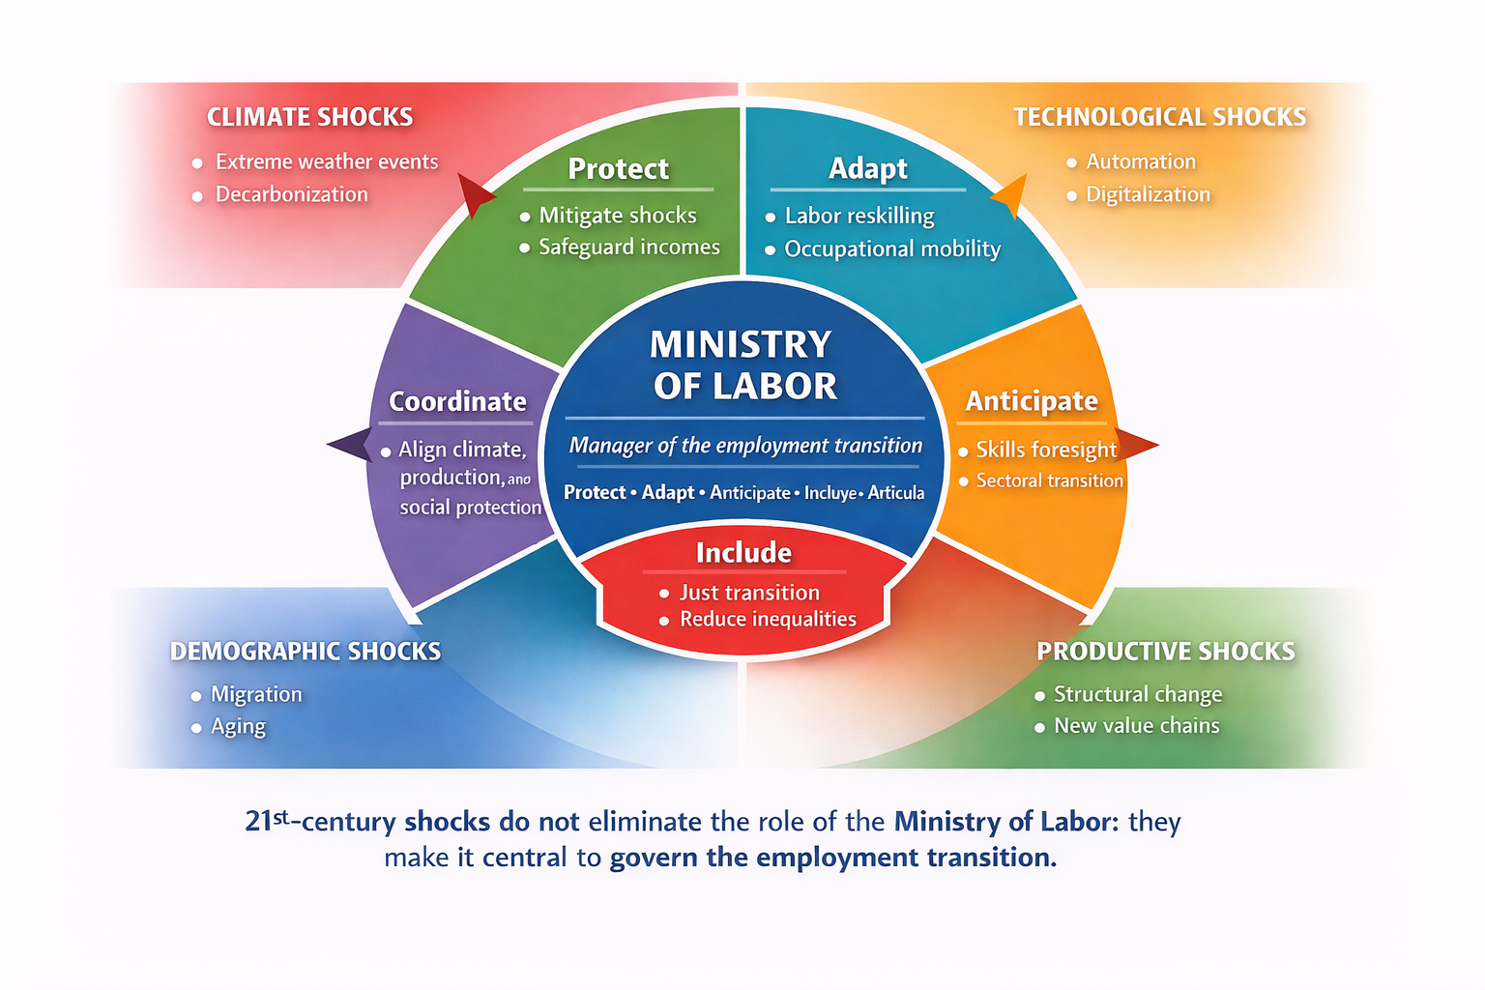
The strategic role of Ministries of Labour in climate‑related disasters
Labour ministries are shifting from reacting to crises to managing labour transitions.
Their role is to anticipate changes in production and prepare people for new jobs.
They act as a bridge between economic policy, social protection, and labour inclusion.

Slide 7
Climate labour policies operate across three-time horizons
RESPOND
ADAPT
TRANSFORM
Short term
Medium term
Long term
Protected income. Temporary employment.
Social protection.
Job retraining
Training
Employment placement
Green jobs.
Just transition. Workplace inclusion

Slide 8
Climate labour policies operate across three time horizons
Policy timeframe | Main objective | Type of intervention | Key instruments | Programme examples
RESPOND (Short term) | Protect incomes and prevent employment losses following climate shocks | Immediate protection of jobs and livelihoods | • Emergency cash transfers• Employment subsidies• Temporary employment programmes• Adaptive social protection | • Trabaja Perú (Peru) • PET – Mexico • Post-hurricane reconstruction programmes (Caribbean)
ADAPT (Medium term) | Reallocate workers and strengthen labour resilience | Labour market adjustment in response to sectoral changes | • Skills reconversion programmes• Training and certification• Labour intermediation services• Support for self-employment | • SENCE labour reconversion (Chile)• Dual training systems (Costa Rica)• Sectoral public employment services
TRANSFORM (Long term) | Structurally transform employment models towards sustainable economies | Productive transformation and sustainable labour inclusion | • Green skills training• Development of green jobs• Just transition policies• Institutional strengthening | • Just Transition Strategy (EU)• ILO-UNEP green jobs programmes• Green hydrogen strategies (Chile, Colombia)

Slide 9
How labour policy responds to climate‑related disasters
The experience of the pandemic demonstrated that governments in the region possess a set of instruments that enable rapid and timely intervention in labour market crises, creating and protecting jobs and incomes and thereby cushioning impacts on the population.
Adapting and strengthening labour market policies in response to climate challenges can be crucial for enhancing social and labour resilience, and for limiting the expansion of poverty and inequality across the region.
Disaster
Protected income
Temporary employment
Economic recovery

Slide 10
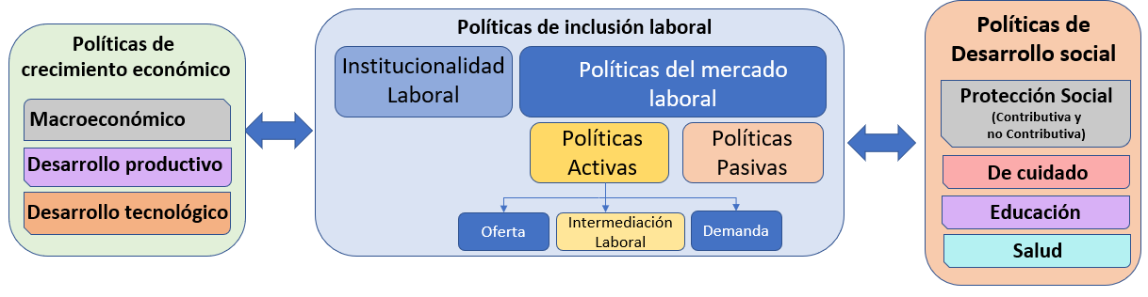
The Ministry of Labour as coordinator of climate‑responsive labour policy
The climate transition simultaneously generates destruction, transformation, and job creation, and therefore requires an integrated framework of labor, economic growth, and social development policies.
A just transition is NOT an additional labor policy. It is part of an inclusive social development model.
Fuente: Comisión Económica para América Latina y el Caribe (CEPAL), Panorama Social de América Latina y el Caribe, 2023 (LC/PUB.2023/18-P/Rev.1), Santiago, 2023.

Slide 11
Typology of labour policies in response to climate disasters
Category | Main objective | Type of policy | Role of the Ministry of Labour | Interministerial coordination | Examples (Country – Programme)
Immediate response | Income and employment protection following a disaster | Active (temporary employment) | Implements programmes and coordinates local hiring | Interior, Public Works, Civil Protection | Mexico – PETPeru – Trabaja PerúColombia – Emergency Employment
Institutionalised emergency employment | Rapid income protection | Passive + Active | Activates subsidy mechanisms and emergency employment programmes | Finance, Social Development, Risk Management | Costa Rica – PRONAEGuatemala – Risk Management Plan
Productive recovery | Restore local livelihoods | Active | Supports labour reintegration and entrepreneurship | Economy, Agriculture, Productive Development | Argentina – Manos a la ObraChile – PEE
Comprehensive reconstruction | Economic and territorial reconstruction | Active + Labour intermediation | Coordinates local employment and job placement services | Housing, Infrastructure, Planning | Honduras – PRE (Eta/Iota)Brazil – Brasil Resiliente
Fuente: Cortínez y Livert, 2026. CEPAL.
Notes:
1. Protección Social Adaptativa: Sistemas que puedan activarse automáticamente ante umbrales climáticos (transferencias, seguros paramétricos).
2. Programas de Empleo Post-Desastre: Experiencias exitosas como el PET (México), Trabaja Perú o PRONAE (Costa Rica) para rehabilitación de infraestructura.
3. Transición Justa: Planificación para la reconversión de habilidades hacia sectores verdes, garantizando que no se incremente la pobreza.
4. Regulación de SST: Ajuste de horarios, pausas térmicas y acceso a hidratación obligatorios por normativa nacional.

Slide 12
Synthesis
The transition generates losses, changes and opportunities. As such, it constitutes a source of employment vulnerability, whose impacts vary according to societies’ capacities for adaptation and response.
Public policies must anticipate the labour risks arising from this process and channel the opportunities of a just transition towards sustainable employment.
A just transition requires strong labour institutions. Ministries of Labour must move from reacting to transforming.
In a context marked by high inequality, it is essential to recognise that risks are differentiated across social groups, sectors and territories, in order to design tailored, effective and equitable policy responses.
.

Slide 13

The Role of Ministries of Labour in Addressing Environmental Transformations in Latin America and the Caribbean
Andrés Espejo
Economic Affairs Officer
UN-ECLAC
Nassau, Bahamas
26 February 2026

